Slide 1
System Development Methods CT00046-3-2
System Analysis – Part 2

Slide 2
Topic & Structure of the Lesson
System Analysis
Data Analysis
System Specification

Slide 3
Learning Outcome
At the end of the module, you should able to:
Explain the tools and techniques used for data analysis and discuss the various requirements in system specification.

Slide 4
Learning Outcome
At the end of the module, you should able to:
Analyze and design different views of a system using tools and techniques.

Slide 5
Key Terms you must be able to use
If you have mastered this topic, you should be able to use the following terms correctly in your assignments and exams:
Systems Analysis Techniques
Analysis Tools
Analysis Outcomes
System Specifications and Requirement.

Slide 6
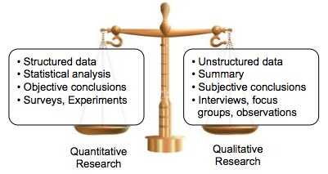
Quantitative vs Qualitative Research and Analysis

Slide 7

Popular System Analysis Techniques … cont Project Analysis
Analysis of factors influencing project
Used by Project Managers to plan large / multiple projects
Tools enable to analyze and determine most efficient use of resources
Ex; Resource Analysis
Financial Analysis
RISK Analysis, etc.

Slide 8

System Analysis Techniques Business Intelligence Analysis
Business intelligence - data analysis that relies heavily on aggregation, focusing on business information.
Using business analysis techniques to find benefits of data to ones business.
Approach;
Seeking product / service opportunities - Ex; SWOT, Fishbone analysis, etc
Analysis of external influences towards the company’s business – Ex; PEST analysis.
Output;
Clearer information for business decisions.

Slide 9

System Analysis Techniques .. cont Data Mining and Analysis
Digging through large amount of data to find relevant / logical information / relationships. (aka; Data Analytics)
Popular Data Mining techniques;
Correlation, aggregation, regression, etc
Focuses on modeling and knowledge discovery for “predictive analysis”
Ex; Study of online customer’s shopping preferences at Amazon.com
Ex; A study of user’s ‘emotions’ at Facebook.com
Output of data mining
Quantitative and Qualitative presented in tabular or visual form.

Slide 10
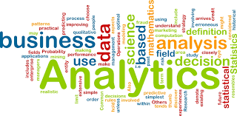
Popular System Analysis Techniques … cont Statistical Analysis
Using numeric data to find / predict data relationships.
Popular Statistical Analysis techniques;
Min, Median, Mode, SD, etc
Correlation, Nominal Comparison, etc.
Focuses on calculating statistics of events;
Ex; Study of stock market, sales, weather based on previous record.
Ex; Reaction of various drugs on cancer patients.
Output
Quantitative data used for prediction / forecasting and conformation of facts.

Slide 11
Analysis Tools
Tools used to collect, store, inspecting, cleansing, transforming, modeling and present data in a useful manner
Advantages
Fast and accurate
Present data in various form better understanding.
Help to create better product / service for users
Disadvantages
Analysis techniques are many and often confusing
Need specific format of data for input
Some tools are expensive

Slide 12
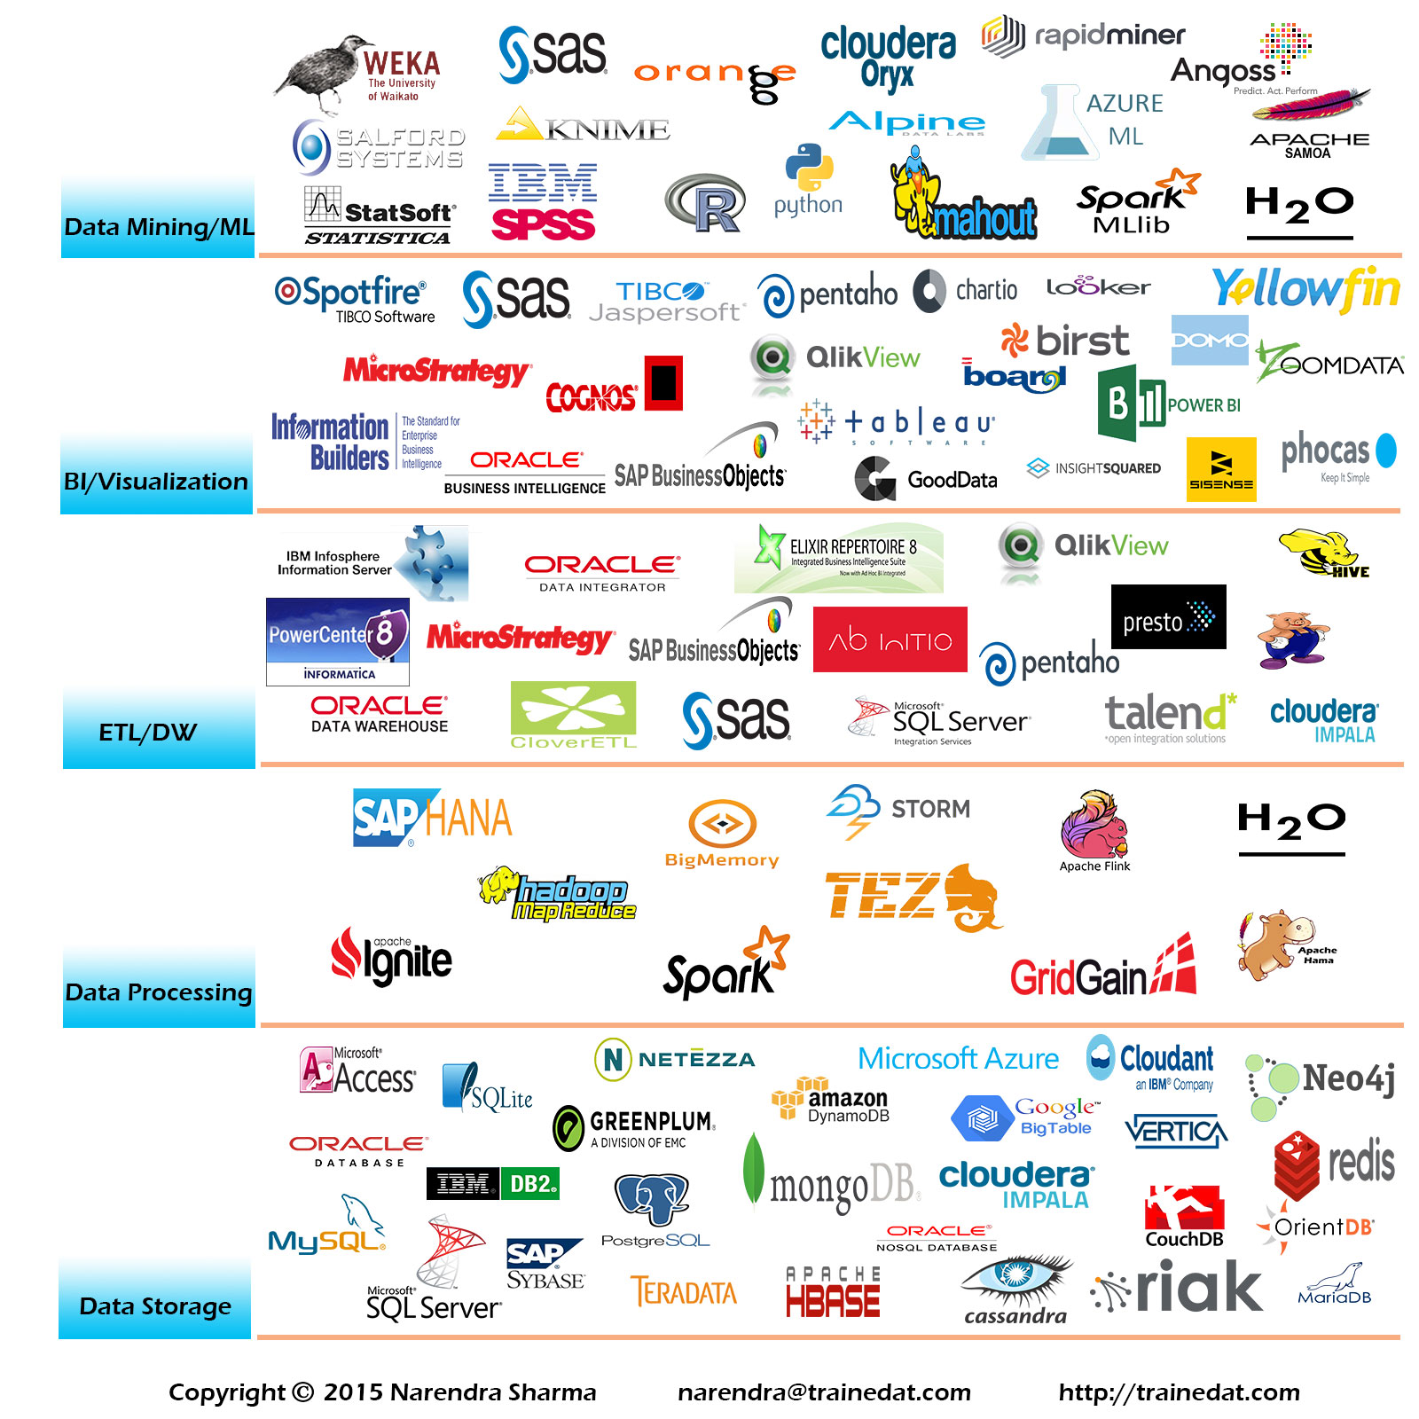
Popular System Analysis Tools

Slide 13
Question & Answer

Slide 14
Next Session
System Design

Slide 15
Tutorial
1. Discuss the advantages and disadvantages of the following data analysis methods;
Data Mining
Statistical Analysis
2. Complete the below table with detailed explanation of latest tools.
Analysis Techniques | Popular Tools | Features of Tools | Advantages of tools | Disadvantages of tools
Statistical Analysis
Data Mining | Ex; Weka, …. | Weka can do ….. | Advantages of Weka ….
Project Analysis
Business Analysis

